Slide 1
SharePoint – Intro Site Management
Kyle Pew
Kyle.Pew@OfficeNewb.com
YOUTUBE: OfficeNewb

Slide 2
SharePoint Topics
Working With Sites
Site Columns & Content Types
Office Integration
Managing SharePoint Site Permissions

Slide 3

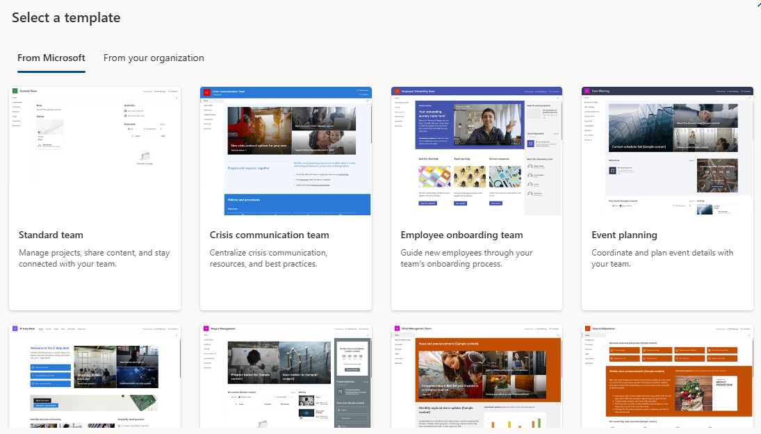
Site Templates/Creating Sites
Site templates help you quickly create consistent SharePoint sites.
Go to SharePoint
Select CREATE SITE
Choose Team site or Communication site
Enter site details
Select Finish

Slide 4
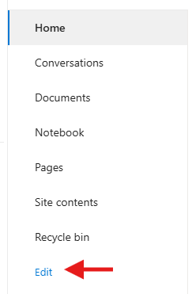
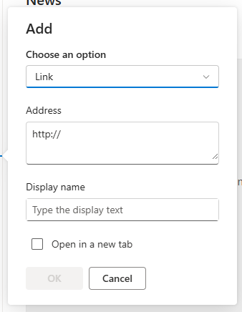
Site Navigation
Site navigation helps users find pages, lists, libraries, and resources.
Select Edit near navigation
Add links
Enter name and URL
Reorder links
Save

Slide 5
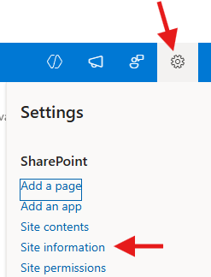
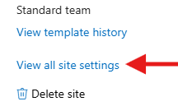

Site Column Gallery
Stores reusable columns for lists, libraries, and content types.
Site Information -- Site Settings
Web Designer Galleries -- Site Columns
  Review existing columns
  Create new columns if needed

Slide 6
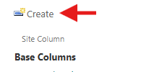
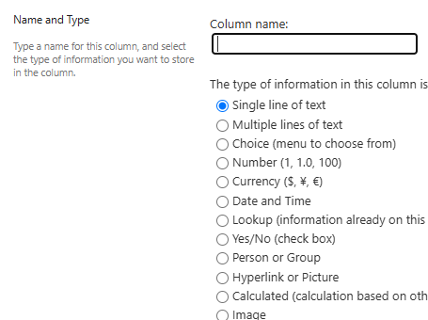
Creating Site Columns
Reusable metadata fields used throughout SharePoint.
Open Site Columns
Select Create
Enter name
Choose column type
Configure settings
Save

Slide 7
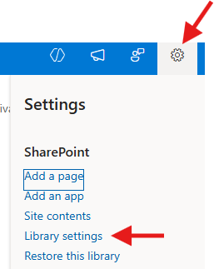
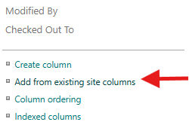
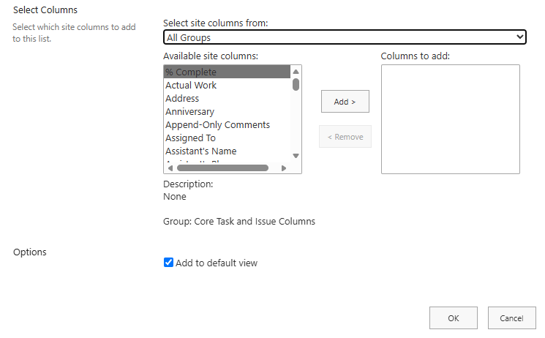
Add Site Column to List/Library
Open List/Library
List/Library Settings
Columns – Add From Existing Site Columns
Choose column – OK

Slide 8

Site Content Type Gallery
Stores reusable content types for documents and list items.
Site Information -- Site Settings
Web Designer Galleries -- Site Content Types
  Review existing content Types
  Create new content types

Slide 9
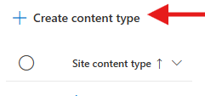
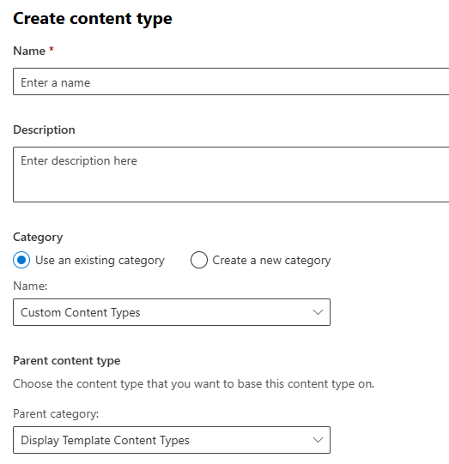
Creating Content Types
Content types standardize documents and list items.
Open Content Type Gallery
Create content type
Enter name and description
Select parent content type
Add site columns

Slide 10
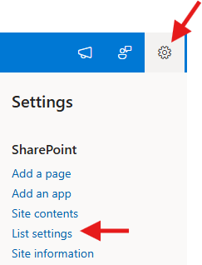
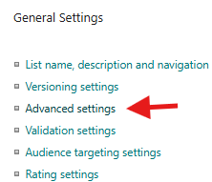
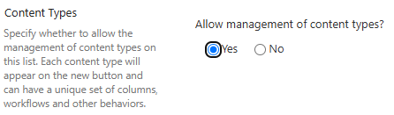
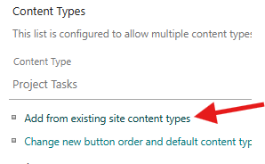
Add Site Content Type to List/Library
Open List/Library
List/Library Settings
Advanced Settings – Allow Management of Content Types – OK
Add From Existing Content Types
Add Custom Content Type

Slide 11
Excel Integration
Store and collaborate on Excel files in SharePoint.
Open a document library
Upload Excel file
Open in browser or desktop app
Share with others

Slide 12
Outlook Integration
Store and collaborate on Excel files in SharePoint.
Open a file or library
Select Share
Enter recipients
Set permissions
Send

Slide 13
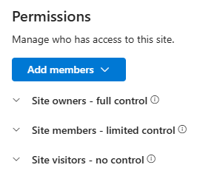
SharePoint Permissions
Controls who can view, edit, or manage content.
Default there are groups to assign users to.
  Owners = Full Control
  Members = Contributors
  Visitors = Read-Only

